Slide 1
Presentation
Team members & Presenters
Leah Hou & Bryce Harlum
Notes:
Entry Page & intro of team – 5 sec

Slide 2
Notes:
Problem Defined – 10s

Slide 3
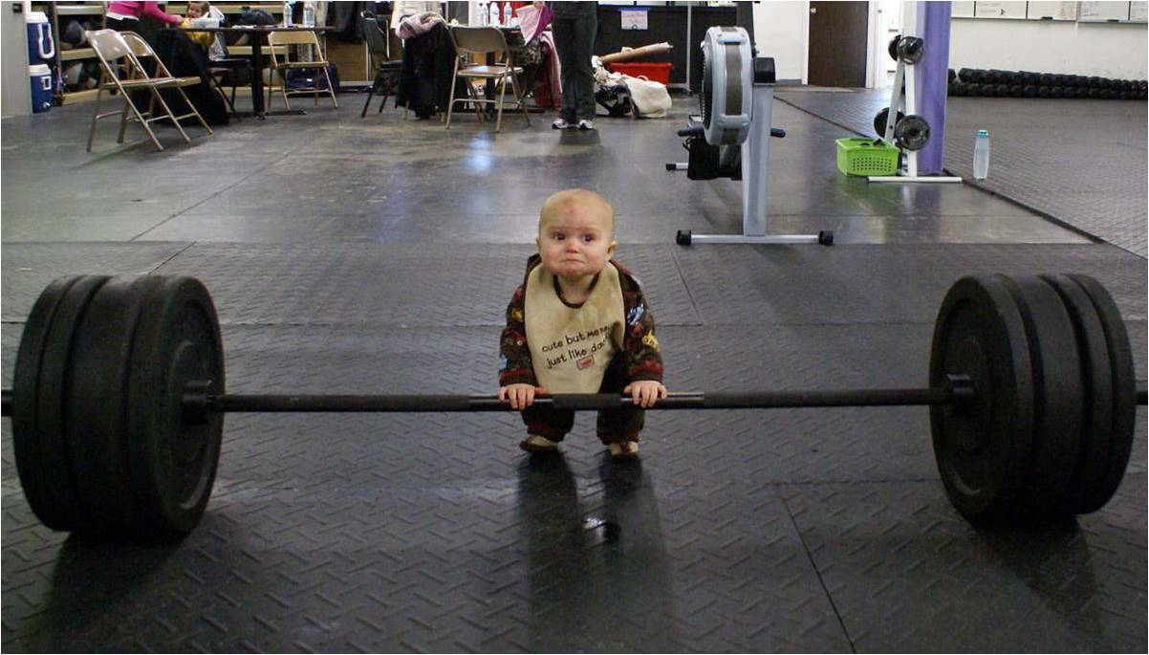
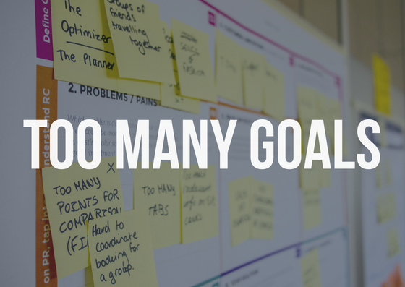

Unrealistic goal
Poor time management
Too many goals
Lack of support
Lack of motivation
Notes:
Possible Reasons for failures – 10 sec

Slide 4

Your solution
Notes:
Solution of the problem – 3 sec

Slide 5
Main Feature of Goalnut
Set multi goals & multi actions to achieve them
Log in your actions
Analyze your activities
Give feedback on:
Diagnose on reasons why goals haven’t met
Advice on unrealistic goals if goals constantly unmet against actions
Provide advice on goals prioritization and time management
Give rewards and encouragement in form of cumulating virtual donuts
Community support by connecting with other goalnut users
Notes:
Master Features of Goalnut – 20 sec

Slide 6
A tour to the terminal app
Notes:
A tour to the terminal app + MVP – 1 mins

Slide 7
Challenge !!!
Notes:
Challenges – 30 secs

Slide 8
Fun parts!
Notes:
Fun parts - 30 secs

Slide 9
Social impact & Unethical use
Positive social impact
The application is created to help people feel positive about their accomplishment when achieving the goal
Implement members with useful tools to achieve their goals
Building a community to help each other achieving what they would like to achieve
Possible misuse of Goalnut
The sense of community should be carefully designed for encouragement and support, and should not be used to increase unnecessary competition.
Goalnut used should be correctly encouraged, rather than being criticized if they haven't achieve their goals
Encourage wrong goal. E.g. encourage eating disorder
Notes:
Social impact and unethical use – 20 sec

Slide 10

Notes:
Q&A – 1 mins

